Slide 1
IME 222: Engineering Graphics Lab Introduction to CATIA
Instructor:
Vishakh Vijayan
Graduate Student
Department of Industrial and Manufacturing Engineering

Slide 2
Overview
What is CATIA?
Understanding CATIA
CATIA User Interface

Slide 3

What is CATIA?
CATIA (Computer Aided Three-dimensional Interactive Application) is a multi-platform CAD/CAM/CAE commercial software suite developed by the French company ‘Dassault Systèmes’.
Written in the C++ programming language, CATIA is the cornerstone of the Dassault Systèmes product lifecycle management software suite.
CATIA supports multiple stages of product development, including conceptualization, design (CAD), manufacturing (CAM), and engineering (CAE).
CATIA facilitates collaborative engineering across disciplines, including surfacing & shape design, mechanical engineering, and equipment and systems engineering.
Source: Wikipedia

Slide 4
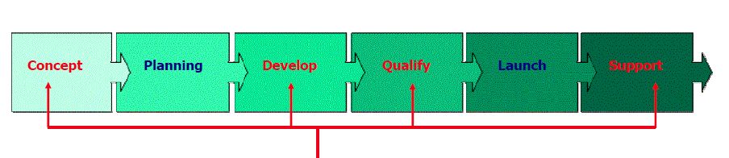

CATIA Scope
CATIA can act as the backbone of various stages in product life cycle, including conceptualization, development, simulation, manufacturing, and after-market information.

Slide 5
Design Intent
The goal of using CATIA is creating a model based on a specific design intent.
“Design Intent is the plan of how to construct the solid model of a part in order to properly convey its visual and functional aspects.
In order to efficiently use a parametric modeler like CATIA, you must consider the design intent before and while modeling the part. The techniques used to create the model will affect how the model behaves when it is changed during its life cycle.

Slide 6
Feature-based modelling
CATIA is feature-based.
CATIA document is made up of individual elements called features.
While creating a document, you can add features such as pads, pockets, holes, ribs, fillets, chamfers, and drafts. As the features are created, they are applied directly to the work piece.

Slide 7
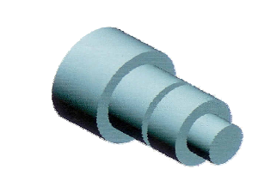
Feature-based modelling
Choice of features and modeling methodology can affect the design intent.
As an example consider creating this shaft:

Slide 8
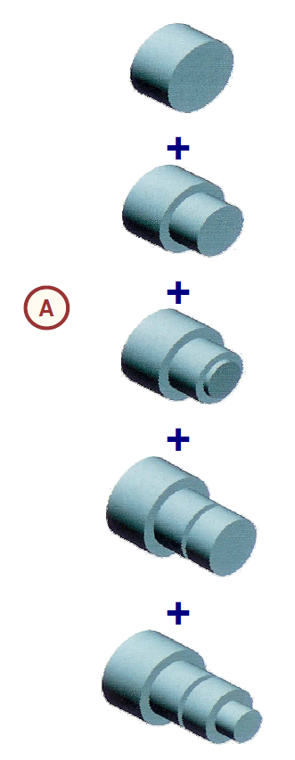
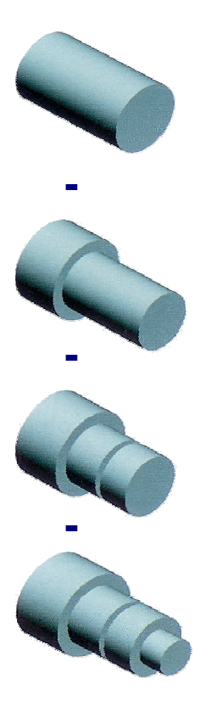
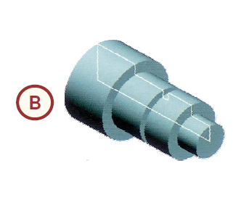

Feature-based modelling

Slide 9
Feature-based modelling
Various approaches exist to model the shaft:
"Layered" Approach
“The layered approach builds the part one piece at a time, adding a layer or feature onto the previous one until the desired solution is obtained.
Changing the thickness or the shape of one layer has a ripple effect; it changes the position or location of all the other layers that were created after it.”

Slide 10
Feature-based modelling
Various approaches exist to model the shaft:
"Potter's Wheel" Approach
“The potter's wheel approach builds the part as a single, revolved feature. A single sketch, representing the cross-section, includes all the information and dimensions necessary to make the part as one feature. While this approach may seem the most efficient, having all the design information contained within a single feature limits flexibility and can make changes difficult.”

Slide 11
Feature-based modelling
Various approaches exist to model the shaft:
"Manufacturing" Approach
“The manufacturing approach to modeling mimics the way the part would be manufactured. For example, if this stepped shaft was turned on a lathe, you would start with a piece of bar stock and remove material using a series of cuts.”

Slide 12
Solid Modeling
CATIA is a solid modeler.
“A solid model is the most complete type of geometric model used in CAD systems. It contains all the wireframe and surface geometry necessary to fully describe the edges and faces of the model. In addition to geometric information, solid models also convey their topology, which relates the geometry together. For example, topology might include identifying which faces (surfaces) meet at which edges (curves).”

Slide 13
Fully Associative
CATIA models are fully associative.
“Changes in the model are automatically reflected in the associated drawings, parts, and/or assemblies. Likewise, changes in the context of the drawing or assembly are reflected back in the model.”

Slide 14
Constraints
CATIA can create constrained models –to capture design intent.
“Geometric constraints (such as parallel, perpendicular, horizontal, vertical, concentric, and coincident) and dimensional constraints (such as length, distance, and angle) establish relationships between the features of a model by fixing their positions with respect to one another. In addition, equations can be used to establish mathematical relationships between parameters.”

Slide 15


Using CATIA
15

Slide 16

Opening CATIA
You can start CATIA by:
Double clicking the CATIA V5R20 icon on desktop.
Going to the installation folder:
C:\Program Files\Dassault Systemes\B20\win_b64\code\bin
And execute “cnext.exe” by double clicking on the file.

Slide 17
CATIA Documents
CATIA output are mostly stored in form of documents. These documents contain information like the geometrical information and specifications of a part.
These documents are stored as files with user defined names and CATIA-specific extensions such as .CATpart, .CATproduct, .CATdrawing, and such.

Slide 18
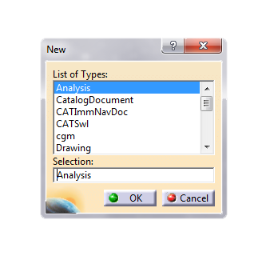
CATIA Documents
For creating a new document, choose File menu, and click on New.
Choose the type of document from the list.
CATIA will automatically launch the default workbench for that type, and open the created document in the default workbench.

Slide 19
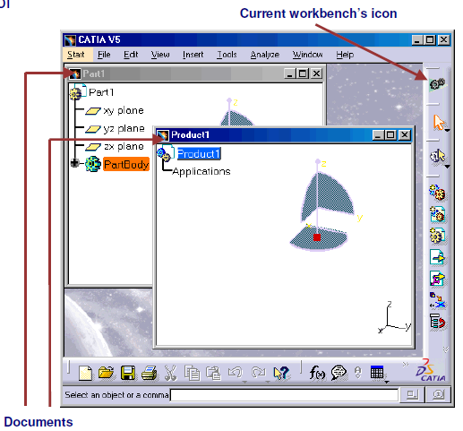
CATIA Workbenches
CATIA provides various workbenches to work on different types of documents.
Part
Part Design
Product
Sketcher
Drawing
Product Design
Surface
Drafting
STL
Rapid Prototyping
CNC Machining

Slide 20
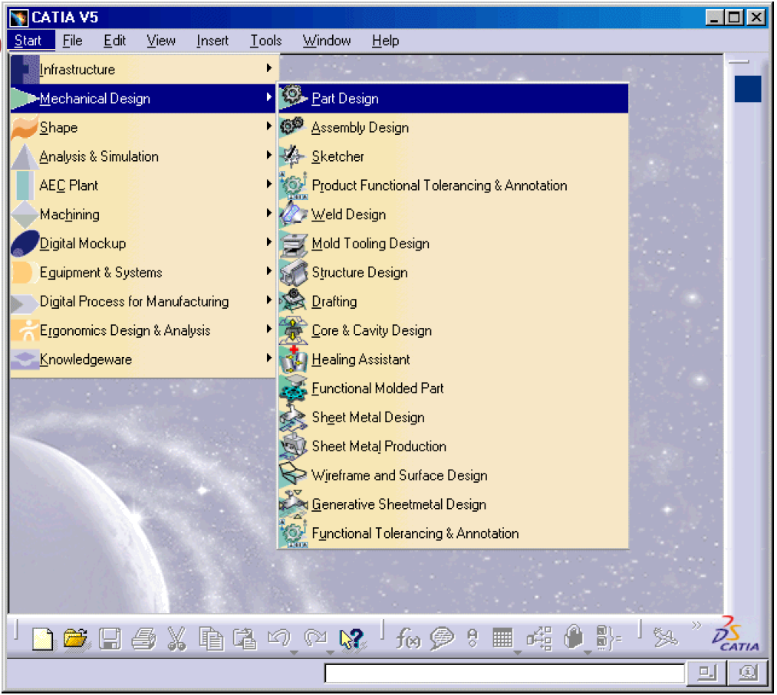
CATIA Workbenches
For launching a specific workbench, choose Start menu, from the list hover over the category till the waterfall list opens. Finally click on the workbench.

Slide 21
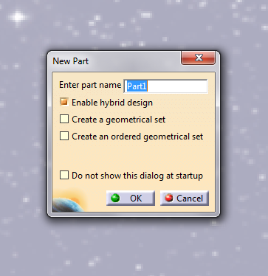
CATIA Workbenches
If there is no open document which the selected workbench can work with, CATIA might prompt you to create a new document.
As an example try launching “Part Design” workbench while no document is open.

Slide 22
CATIA User Interface
22

Slide 23
CATIA User interface (Windows)
CATIA uses typical Windows commands such as copy (Ctrl+C), cut (Ctrl+X), and paste (Ctrl+V).
CATIA is designed for Windows operating system and uses Windows graphical user interface –GUI, elements, such as:
Windows
Forms
Menus
Submenus
Contextual Menus
Toolbars
Dialog Boxes

Slide 24
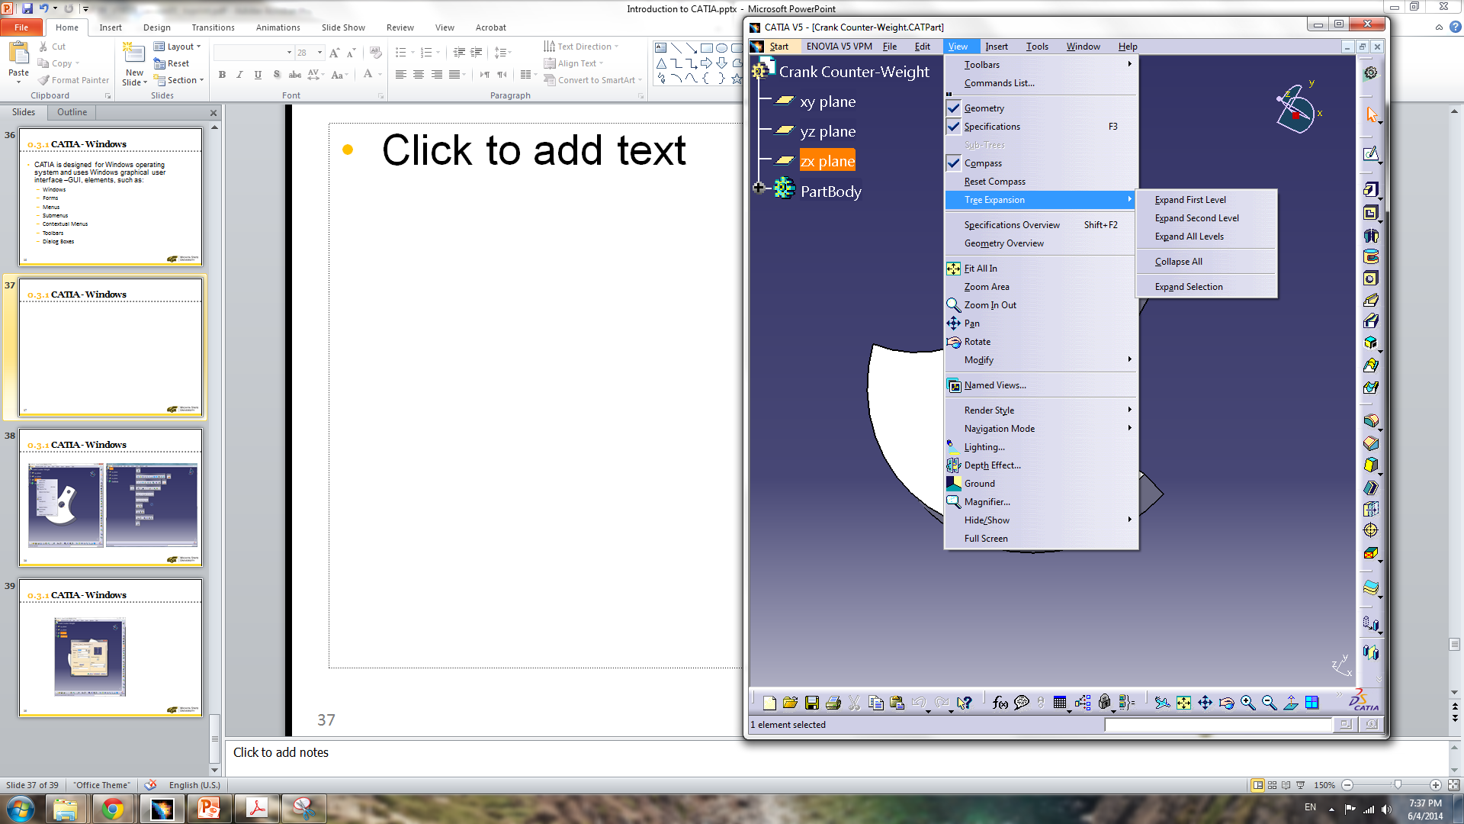
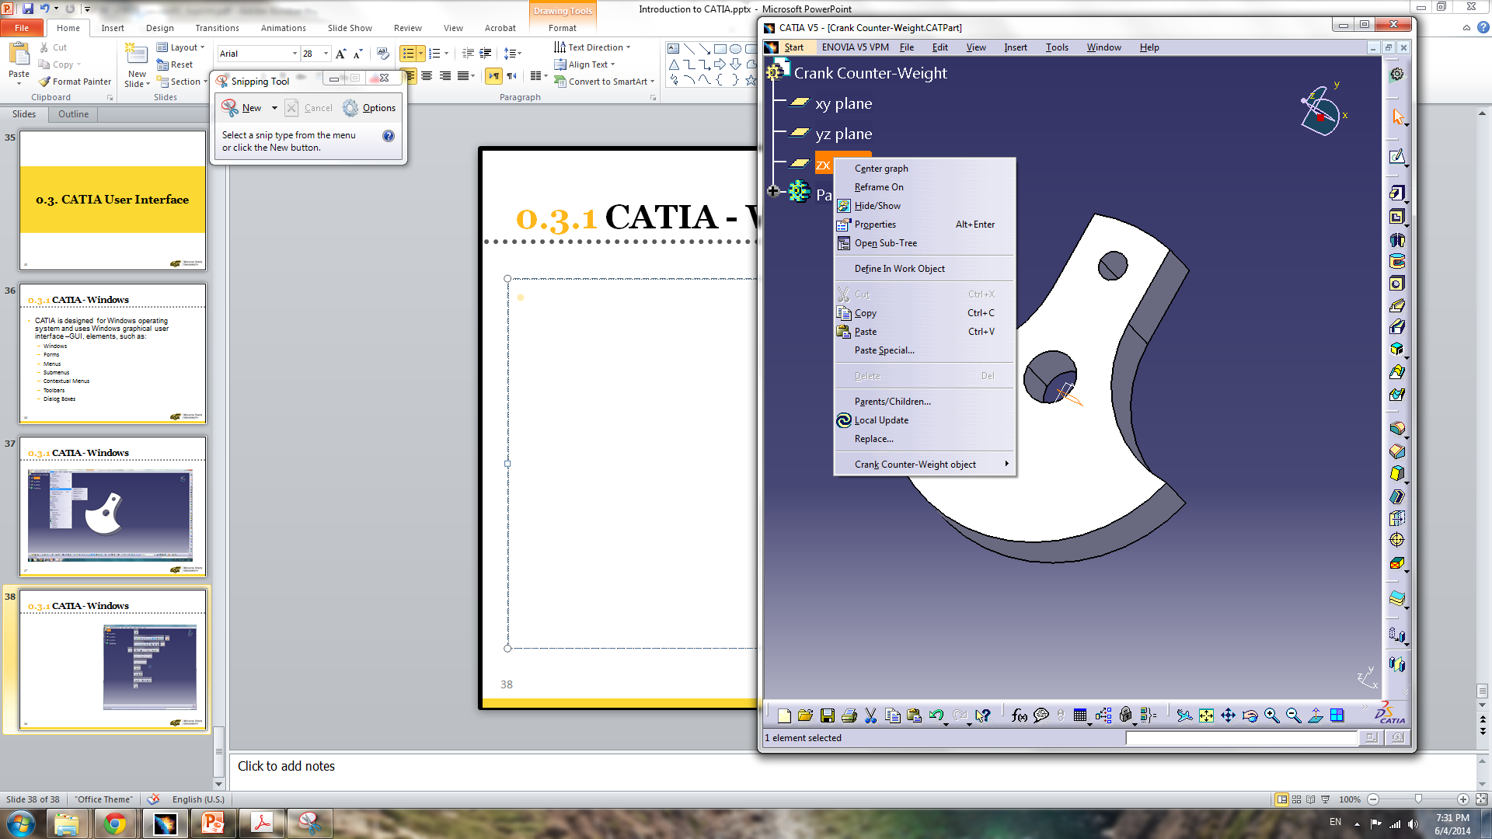
CATIA User interface
Main Menu
Submenu
Toolbars
Contextual Menu
Menu

Slide 25
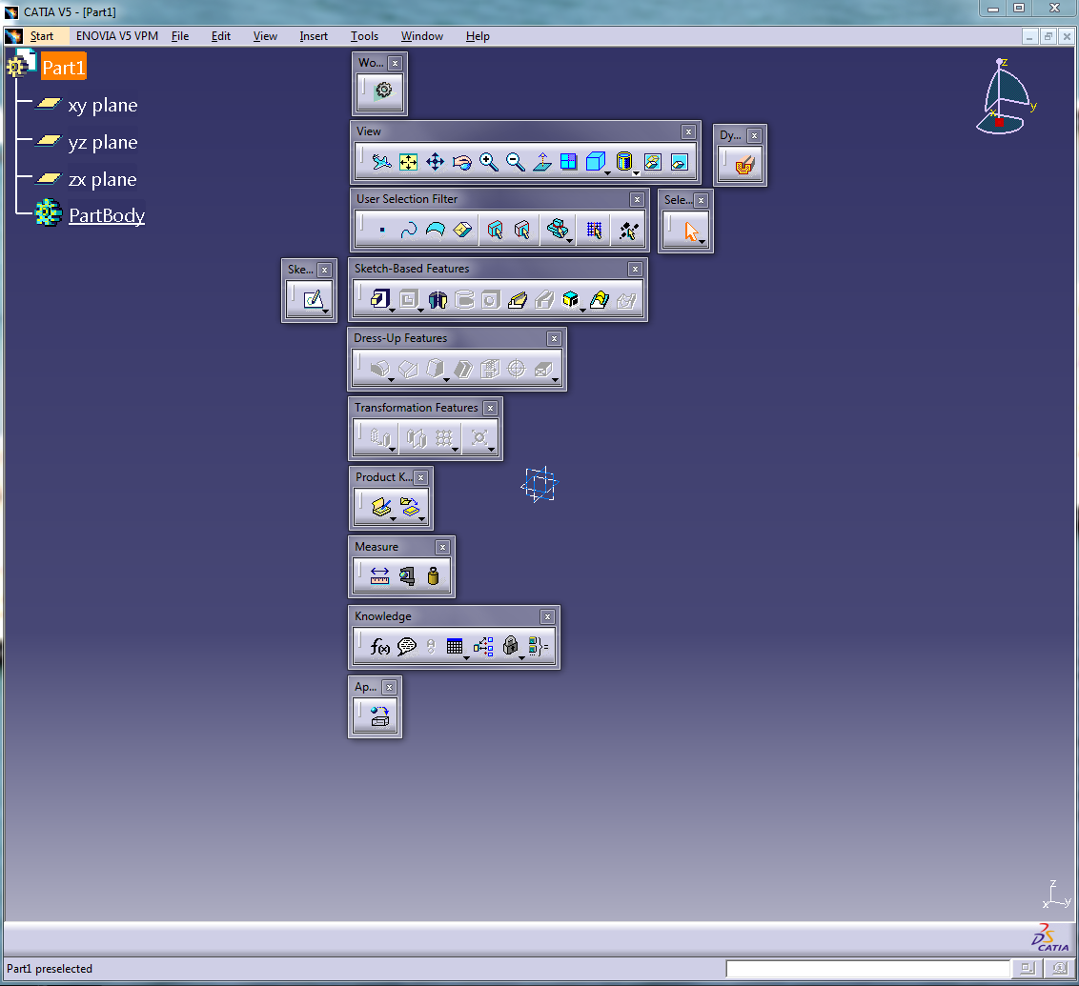
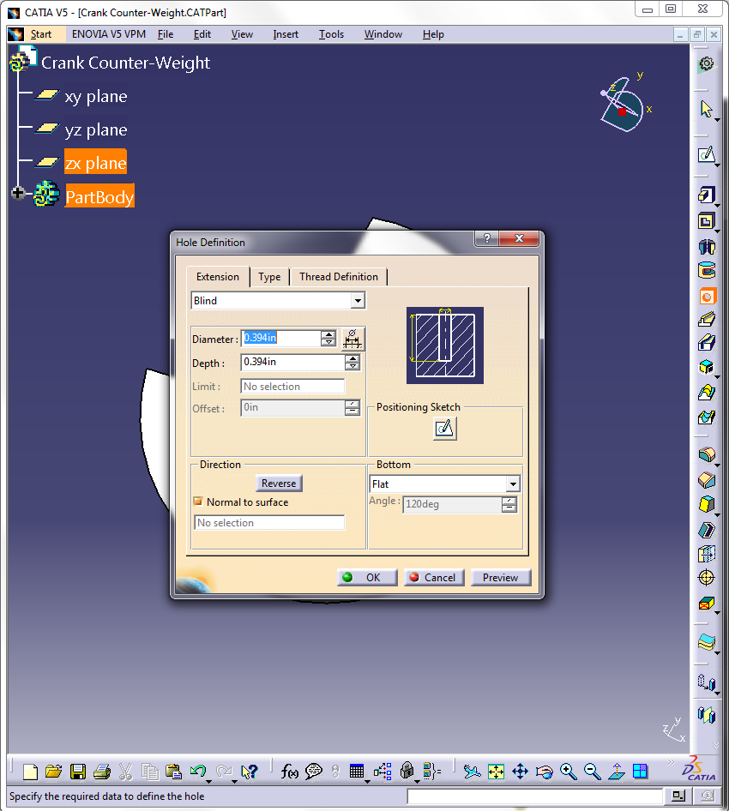
CATIA User interface
Dialog Box
Toolbars

Slide 26
CATIA User interface
Toolbars:
“Toolbars contain icons for quick access to the most frequently used commands.”
“Toolbars are organized into workbenches.” Different workbenches have different toolbars.
“Toolbars can be customized, rearranged, and relocated as per your preferences.”
Toolbars can be docked and undocked.
Toolbars can be arranged vertically or horizontally.
“Some toolbar icons have additional icons related to them. An arrow (pointing downwards) besides an icon means more tools of the same type are available under it.”

Slide 27
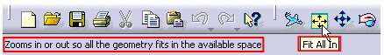
CATIA User interface
Mouse:
The left mouse button (MB1) is used for selecting items and launching commands if clicked.
The middle mouse button (or wheel) is used for scrolling lists and trees if rolled or for pointing to a direction if clicked.
“The right mouse button (MB3) is used to display a contextual menu for the currently selected or preselected elements on the screen.”
“The mouse cursor is represented by different symbols to indicate various statuses.”
“A ToolTip and a short help message is displayed when you place the mouse cursor over a particular tool.”

Slide 28
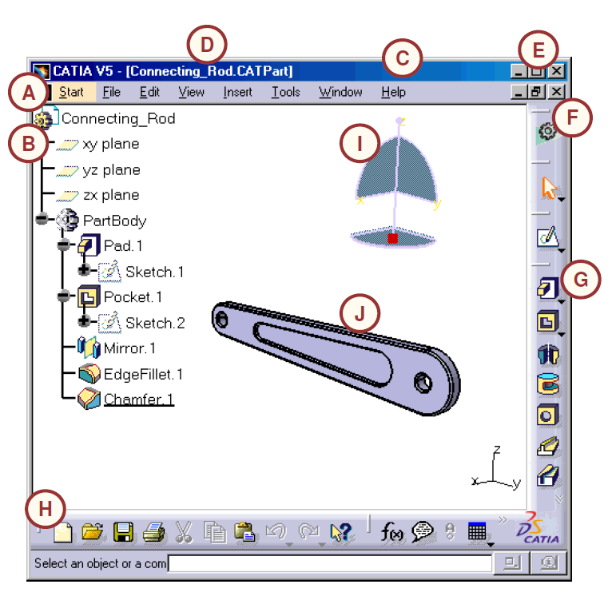
CATIA User Interface Layout
A typical list of CATIA application GUI elements are:
A. Menu Commands
B. Specification Tree
C. Window of the active document
D. Filename and extension of current document
E. Icons to maximize, minimize, and close the main CATIA window
F. Icon of the active workbench
G. Toolbars specific to the active workbench
H. Standard toolbar
I. Compass
J. Geometry area

Slide 29
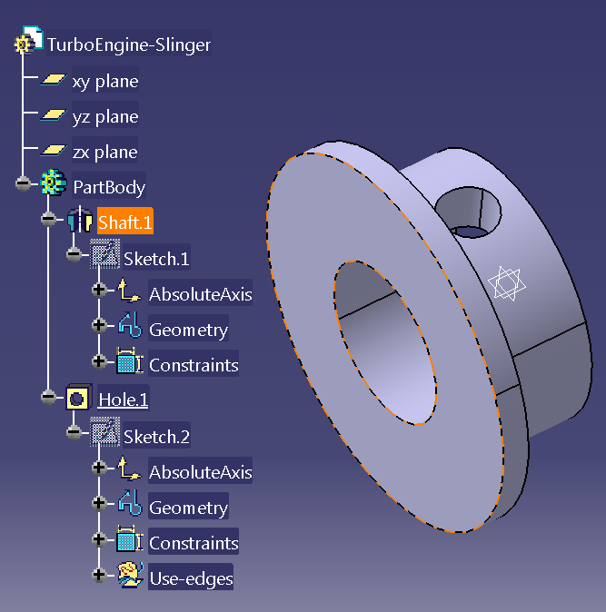
Specifications Tree
CATIA V5 provides a specification tree, which keeps the hierarchy of features, constraints, and processes, and the assembly information for a CATIA document.
The specification tree provides a visual step-by-step record of the sequence followed while creating a solid model.

Slide 30
Specifications Tree
You can edit, reorder, or remove steps in the design process and specifications to achieve a new finished part without having to recreate the model.

Slide 31
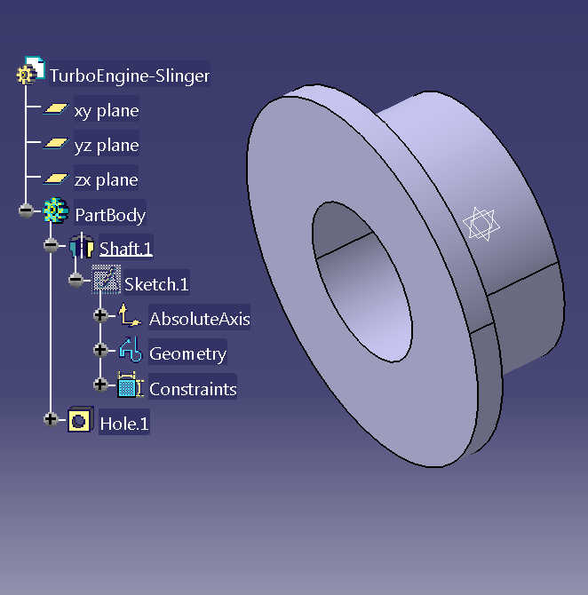
Specifications Tree
The specification tree can suppress certain features and information by temporarily removing them from consideration for the model.
For example, the model on the right contains one hole features. You can simply “turn off" (suppress) the hole and have the model reflect the base area without actually deleting the hole.

Slide 32
Specifications Tree
The underline feature indicates the “In Work Object” (feature).
Every feature below the “In Work Object” is suppressed.
In order to define a feature as “In Work Object”, right click on the feature and select “Define In Work Object” command from contextual menu.

Slide 33
Specifications Tree
You can use specifications tree to select or deselect an item.
In order to select and item, left click on the item in specifications tree.
You can use specifications tree to show/hide an object.
In order to show/hide an object, right click on the object and select “Hide/Show” command from contextual menu.

Slide 34
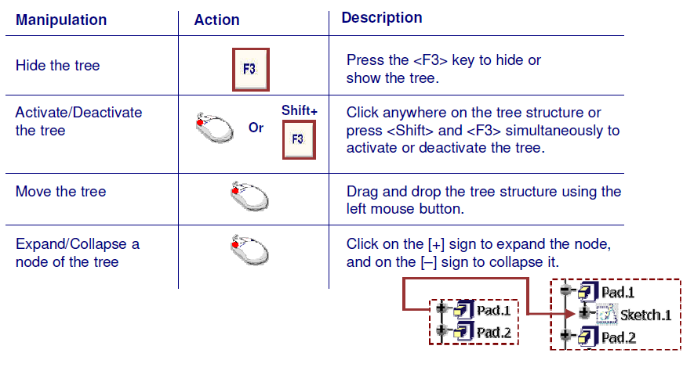
Specifications Tree
You can manipulate specifications tree view.

Slide 35
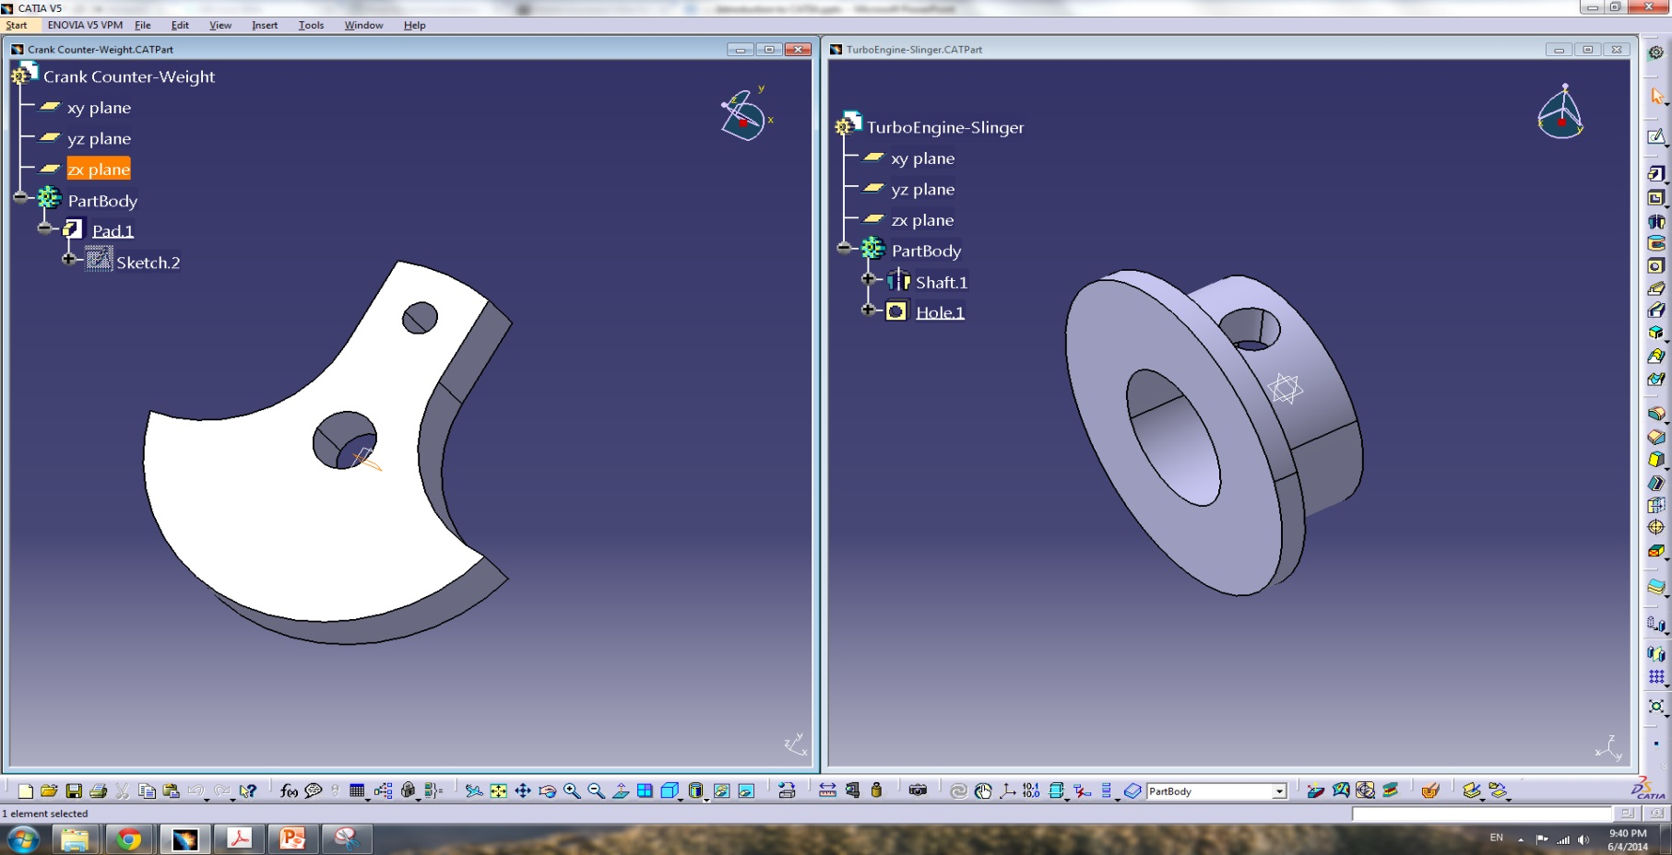
Active Document Window
CATIA is a multi document interface application. CATIA main window can open multi documents in separate windows.

Slide 36
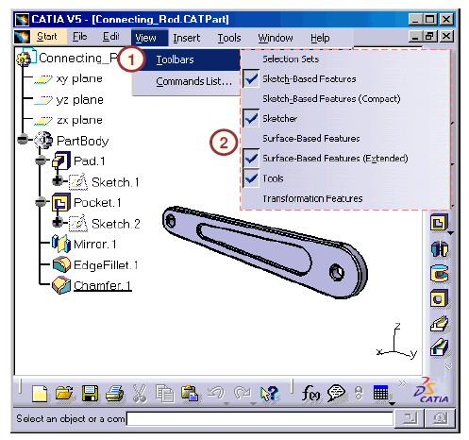
Toolbars
Toolbars provide quick access to tools that are also available in the menus. Use the following steps to activate/deactivate a toolbar:
Click View > Toolbars.
A list of toolbars is shown with respect to the current workbench.
Activated toolbars have checkmarks beside them.
Select a particular toolbar to activate or deactivate it.

Slide 37
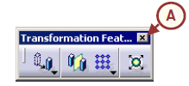
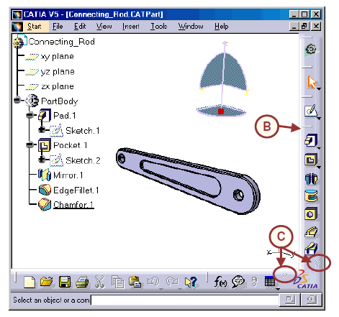
Toolbars
You can further manipulate toolbars to close, reorganize, or display them:
Click Close to deactivate a floating toolbar.
Reorganize the toolbars by dragging the separator of any toolbar and moving it to another location on the screen.
A double-arrows (>>) symbol in the corner of the toolbar area indicates that there are more tools available, but are not visible due to the window’s size. Drag the symbol to the Geometry Display Area to view these tools.

Slide 38
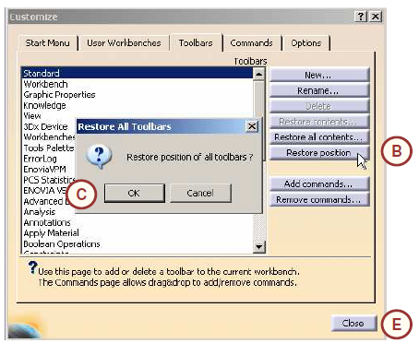
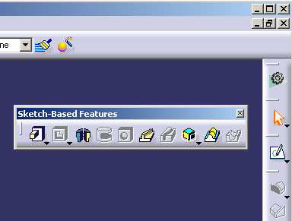
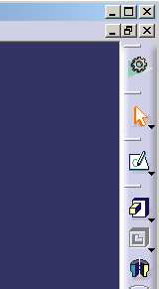
Toolbars
You can reset the original toolbar configuration as follows:
Click Tools > Customize to access the dialog box.
Using the Toolbars tab, click the Restore Position button.
Confirm by clicking OK.
The floating toolbar will be reset to its original fixed position.
Click Close to exit.

Slide 39
Toolbars
Since CATIA contains a large number of tools and toolbars, it is not possible to display all of them within the limited window space. CATIA manages this using collapsible toolbars and by stacking extra toolbars at the corners of the window. (C)

Slide 40
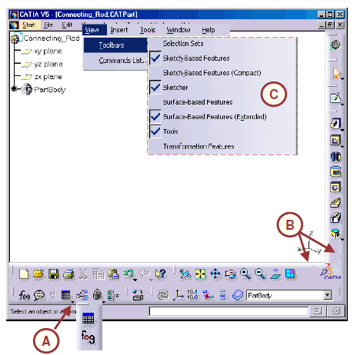
Toolbars
If you are unable to find a tool/toolbar, ensure that:
The tool you are looking for is not located as a “fly out” optional tool. CATIA groups variants of the same tool into a single display group, which can be accessed by clicking the black arrow.
The tool/toolbar is not located outside the display area. Look for the >> symbols at the corners of the window. You can drag the toolbar out to see all the tools.
The toolbar is active.

Slide 41
Compass
Besides being an orientation reference tool that helps while performing view rotations, the Compass is a powerful tool that can be used to physically move and manipulate objects. This is especially useful in Assembly Design, Freestyle, and Digital Mockup workbenches.
By default, the base of the Compass (also called the Privileged Plane) is the XY plane. The default orientation of the compass is parallel to the reference XYZ axis system and is located to the top right corner of the screen.
If the 3D view is changed, the Compass updates its orientation to reflect the new viewing angle/direction.

Slide 42
Geometry Area
CATIA visualize model in the geometry area.
You can manipulate geometry area and perform operations such as zoom, pan, and rotate by:
Using View toolbar* (a standard toolbar)
Using mouse*
Hold middle mouse button/wheel to pan the view
Hold middle mouse button/wheel, then right click once (or hold Shift key at the same time) and move the mouse to zoom in/out the view
Hold middle mouse button/wheel and right mouse button (or Ctrl key) at the same time; and move the mouse to rotate the view
Using compass
Drag the plane (xy, yz, zx) to pan the view on the respective plane
Drag the axis (x, y, z) to pan the view along the respective axis
Drag the curve around the axis (x, y, z) to rotate the view around the respective axis
Drag the top dot around the red dot to rotate the view freely around the view center
* You can use same directions to manipulate specifications tree if the specifications tree is activated.

Slide 43
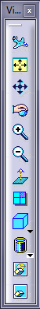
Geometry Area
View toolbar provides following operations:
Fly Mode (set view mode to fly mode)
Fit All In (fit all the model into the screen)
Pan (move the camera on the screen plane)*
Rotate (rotate the camera around the center of the view)
Zoom In
Zoom Out
Normal View (Normalize camera to the selected plane or face)
Create Multi-view (Create 4 views – isometric, top, front, right)
View (Change view to predefined views)
Shading (change the model shadings)
Hide/Show (hide/show selected part)
Swap Visible Space (switch between visible and hidden elements of the model)

Slide 44
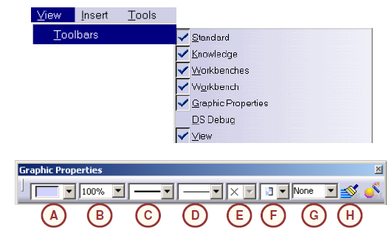
Graphic Properties
The Graphic Properties toolbar enables you to change various graphical properties of elements displayed on the screen. It provides tools to change the following properties:
Fill color
B. Transparency
C. Line thickness
D. Line type
E. Point symbol
F. Rendering style
G. Active Layer
H. The Painter tool copies the graphic properties of one feature to another”

Slide 45
Graphic Properties
In order to use the Graphic Properties toolbar to change the element(s) graphical properties:
Select the element(s) using the left mouse button.
Select the Graphic Properties toolbar, and change the required graphic properties.

Slide 46
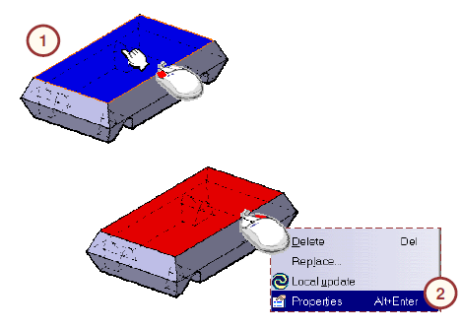
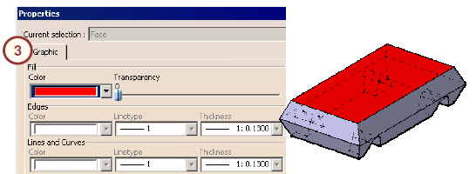
Graphic Properties
Alternatively, you can use the following steps to change the graphic properties of an element:
Select the element(s) using the left mouse button.
Right-click and select Properties in the contextual menu.
Select the Graphic tab, and change the required graphic properties.”

